Slide 1
My World Flow
A Workflow Engine

Slide 2
What’s MWF
My World Flow, a workflow engine run as a service in the cloud.
MWF is a workflow engine
that can be used remotely to drive either human-oriented workflow or computer-oriented business process, also in a hybrid mode.
MWF runs in the cloud
no installation is required. Business sensitive data is kept on your side while MWF take care of driving your workflow processes.
MWF provides Restful API
and GUI workflow designer as well as process monitor to programmers who can integrate advanced workflow features in your application with any modern computer language.
MWF has workflow designer, monitor, full set Restful APIs.
MWF support very complex workflow logic: sequence, parallel, AND, OR, script, sub-process, vote, timer etc.

Slide 3
How to start
Register
an MWF account
Try MWF?
MWF demo site
Need examples for how to integrate MWF into your application
Learn MWF APIs
Integrate full-featured MWF workflow functions into your application

Slide 4
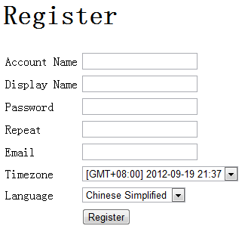
Register MWF account
Access http://www.myworldflow.com/cflow/reg.jsp

Slide 5
MWF APIs
Restful API:
http://www.myworldflow.com/cflow/tutorial/mwf_api.html
With Restful API, you can integrate MWF into your programs with any modern languages.
JAVA SDK:
http://www.myworldflow.com/cflow/tutorial/sdk.html

Slide 6
Basic Concept: User Account
User who participates in workflow collaboration should have an MWF account
One can register MWF account on MWF website.
A registered user can create many other user accounts with MWF API.

Slide 7
Basic Concept: Organization
Organization is a business boundary.
A user can assign tasks to other users within same organization.
A user can team-up with other users within same organization.
A can team-up with B since they both belongs to Org X
A can team-up with C since they both belongs to Org Y
C can NOT team-up with D since they don’t belong to a common organization
A
Org X
Org Y
B
Org Z
C
D

Slide 8
Basic Concept: Team
Team defines role-user map
Within one team:
A role can map to many users
A user can take many roles
Role E
User 1
Role D
User 2
Role C
User 3
Role B
User 4
Role A
User 5

Slide 9
Basic Concept: Task assignation
In workflow template, a task can be assigned to one to many users, or one to many roles.
if a task is assigned to role, and if a team is specified when a workflow is started, then the real task assignation will be determined by role-user map definition is the team.

Slide 10
Role-User Mapping
Team 1
Workflow Process 1
A
Task 1
R
A
B
B
Task 2
Workflow Template
A
B
D
Task 3
S
C
A
B
Task 1
Task 4
A
B
D
A
D
Task 2
Task 5
R
S
Starter
Task 3
Task 6
R
A
B
Task 4
S
Task 5
Workflow Process 2
T
Team 2
Task 6
Task 1
Task 3
A
A
B
R
Task 2
B
C
D
Task 3
C
S
C
Task 4
D
D
Task 5
Starter
A
User name
Task 6
C
R
Role name
Task 3
Referral task name

Slide 11
Workflow Designer
Use MWF demo site’s workflow designer
After login, click menu “Template Library” then click “Create a new workflow template”
Or copy MWF demo site’s workflow designer HTML source to your own web server, then modify as necessary.

Slide 12
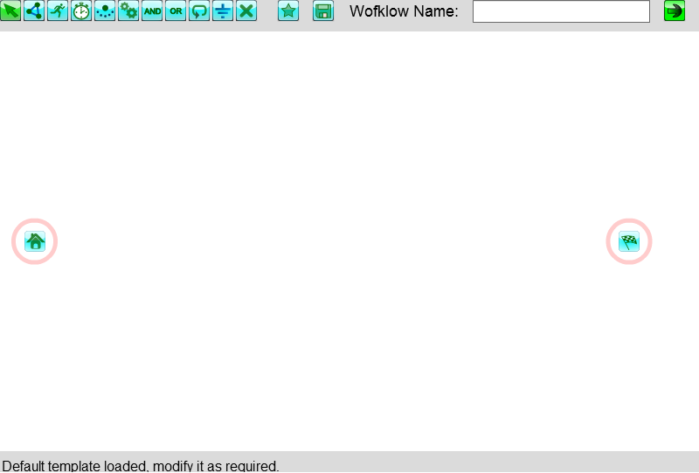
Workflow Designer: UI
Toolbar
Canvas
Status

Slide 13
Workflow Designer: Toolbar
Delete: click a node or a link to delete it
Ground: complete one branch
Round: mark to rewind back to any previous node
OR: pass when any one of previous tasks is completed
AND: pass only when all previous tasks are completed
Script: invoke Javascript, JAVA or remote web services
Sub: include a sub-process
Timer: a timeout timer, process will hold untile timer expired.
Task: a task should be done by people
Link: click first node then click next node to link them up, a link means a workflow routine.
Select: click to select a node or a link

Slide 14
Workflow Designer: Toolbar
Workflow Name: the name of the current template
MAX: maximize the designer window
Save: save current workflow template
New: create a new workflow template

Slide 15
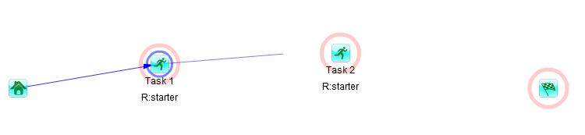
Workflow Designer: Link
Click on one node (the preceding task)
Click on another node (the following task),
An arrow will be draw between these two nodes.

Slide 16
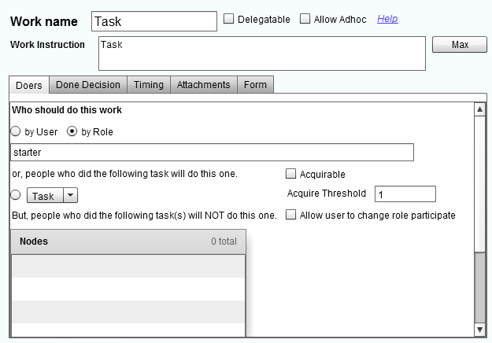
Workflow Designer: Task Doers
Work name
Work Description
Allow to delegate?
Allow to add adhoc tasks?
Will be done by user?
Will be done by role?
Comma separated user or role list
Acquirable?
Allow to change role participation?
Will be done by same DOER(s) as another task?
Except DOER(s) who have done other tasks

Slide 17
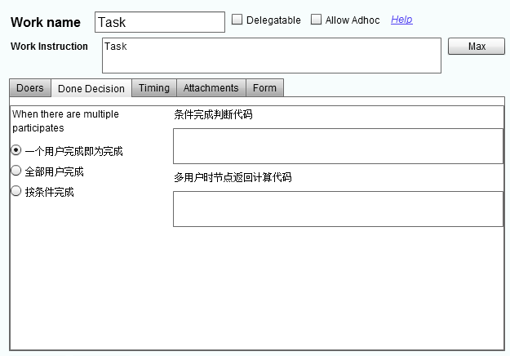
Workflow Designer: Done Decision
If the task will be dispatched to many users, how to determine the task is DONE?
One people complete, then DONE
All people complete, then DONE
Determine by condition
The condition script. Put return value to “ret”. If the return value is “true”, then the task is completed. for example, 60 percent people has completed this task:
if(finished/total > 0.6) ret=“true”; else ret=“false”;
Compute the return value of this task when there are many DOERs
Write javascript code. The process contextual values are presented in a JSON variable CTX. You must write the return value to variale “ret”, for example: if(CTX.leave_days>10) then ret = “A”; else ret = “B”

Slide 18
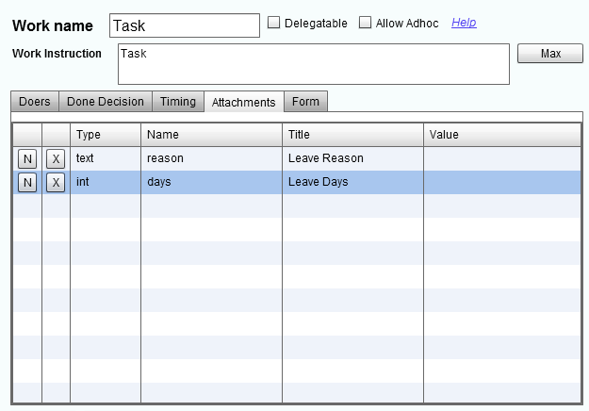
Workflow Designer: Task variables
Attachments are variables which will be displayed on task form, DOER should input their value.
Developer should display task forms.
Developer call MWF restful API
/cflow/rest/task?tid=TASK_ID to get task contextual information, and display the form as will (take demo site as example to display your own form.)
Variable default value.
Variable title: for display
Variable name: a valid JAVA variable name.

Slide 19
Workflow Designer: Task variables
Define task varialbes in Workflow Desginer
Get task information with Restful API: http://www.hostcflow/rest/task?tid=TID&acsk=ACSK
The above API return a JSONObject: task
The variables are in task.ATTACHMENTS, which is a JSONArray
Show these variables as HTML form input area, you may also use Velocity to customize form per task.
When user submit a task, read these input and compose a JSON string: {[variable_name”:”variable value”],}
Post to http://host/cflow/rest/task
Check /cflow/task.jsp source code to learn more.

Slide 20
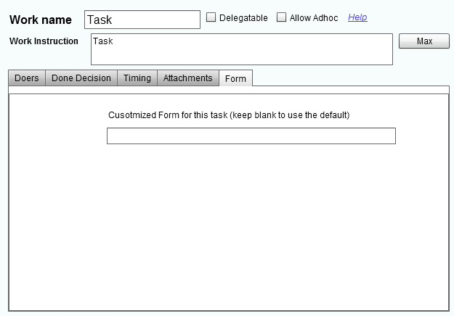
Workflow Desinger: form identity
Form ID:
/cflow/rest/task?tid=TASK_ID to get task contextual information which contain this form id.
Developer may use this ID to distinguish forms displayed for different tasks.
Developer can also distinguish task forms by task name when every task has different name.

Slide 21
Workflow Designer: SCRIPT
MWF support three sorts of scripts
Javascript
Locale JAVA invocation
Remote WEB resource call
A script node’s return value is used to routine the workflow process
Process contextual variables can be changed within a script.

Slide 22
Workflow Script: JAVASCRIPT
Write Javascript codes directly.
Should return a String value.
The returned value will be treated as this script node’s return value, which will be used to determine workflow’s following routine.
For example: if(days>10) return 'long'; else return 'short'; “days” is a process variable which has been define as an attachment of a previous node, use it directly in your script.

Slide 23
Workflow Script: JAVA
Format JAVA:java_class_name
The java class must be implements “com.lkh.cflow.Linker” and implement “public String linkProxy(JSONObject ctx)”
See com.lkh.cflow.test.MyLinker source code for example
The class must return a JSON with keys:
“RETURN”: the value will be the tasks’ return value
Other keys: if there are process variables with same name, the values of these process variables will be replaced with JSON key’s value.
Script node’s return value is used to determine following workflow routine.
The class must be in same CLASS Loader as MWF server.

Slide 24
Workflow Script: call WebService
Format URL:http://.....
See com.lkh.cflow.test.TestScriptWeb source code for example.
The URL can be on any remote server.
The WebService must return a JSON with keys:
RETURN: the value will be the tasks’ return value
Other keys: if there are process variables with same name, the values of these process variables will be replaced with JSON key’s value.
Script node’s return value is used to determine following workflow routine.
Noramlly, the URL refers to a Servlet, a JSP, a Restful API, or a SOA Web service address.
MWF pass contextual information to remote web service as a request parameter “CTX” which value is a JSON String, in your codes, you should parse it to a JSON Object, and read it’s key values which then will be used in your own codes.

Slide 25
Junit Test: Script example
<!-- Apply Leaving, should input days and reason -->
<node id="id_apply_leaving" type="task" title="Apply Leaving" name="Apply Leaving">
<attachment type="int" label="Leave days" attname="days" value=""/>
<attachment type="String" label="Leave Reason" attname="reason" value=""/>
<taskto type="role" whom="starter"/>\n <mpcdc/>\n <oec/>
<next targetID="id_script"/>
</node>
<node id='id_script' type='script'>
<script>URL:http://REMOTE_SERVER/cflow/TestScriptWeb</script>
<next option='long' targetID='id_long'/>
<next option='short' targetID='id_short'/>
</node>
<node id='id_long' type='task' name='LONG'>
<taskto type="RefertoNode" whom="id_apply_leaving"/>
<next targetID='id_end'/>
</node>
<node id='id_short' type='task' name='SHORT'>
<taskto type="RefertoNode" whom="id_apply_leaving"/>
<next targetID='id_end'/>
</node>

Slide 26
Junit Test: Script example
String wftid_script_web = client.uploadWft(accessKey, wft_script_web, "testProcess_5");
prcid = client.startWorkflow(accessKey, "U3306", wftid_script_web, teamid, "testProcess_5");
// id_apply_leaving
//Get worklist
wlist = client.getWorklist(accessKey);
assertTrue(wlist.size() > 0);
//A workitem with id: id_apply_leaving should exists.
theWii = client.getWorkitem(wlist, prcid, "id_apply_leaving");
assertTrue(theWii != null);
//Do “apply leaving” task, reason is “go home”.
JSONObject beforeScript = client.getPrcVariables(accessKey, prcid);
client.doTask(accessKey, prcid, (String) theWii.get("NODEID"), (String) theWii.get("SESSID"), null, "{\"days\":\“9\", \"reason\":\"gohome\"}");
// Here, the script node will be executed. com.lkh.cflow.test.MyLinker.
// will write "test value to change back to process attachment" back to
// “reason”
//Get process contextual variables after the script executed.
JSONObject afterScript = client.getPrcVariables(accessKey, prcid);
//The previous value of varialbe reason should be “gohome”
assertTrue(beforeScript.get("reason").equals("gohome"));
//After script execution, the value should be changed.
assertTrue(afterScript.get("reason").equals("test value to change back to process attachment."));
assertTrue(afterScript.get("ignored") == null);
//Process should run to id_short node.
wlist = client.getWorklist(accessKey);
theWii = client.getWorkitem(wlist, prcid, "id_short");
assertTrue(theWii != null);
assertEquals(theWii.get("WORKNAME"), "SHORT");

Slide 27
TestScriptWeb code snippest
protected void doPost(HttpServletRequest request, HttpServletResponse response) throws ServletException, IOException {
request.setCharacterEncoding("UTF8");
String ctx_string = request.getParameter("CTX");
JSONParser parser = new JSONParser();
JSONObject ctx;
String ret = "";
try {
ctx = (JSONObject) parser.parse(ctx_string);
JSONObject attachments = (JSONObject) ctx.get("ATTACHMENTS");
String days = (String) attachments.get("days");
int idays = Integer.valueOf(days).intValue();
if (idays > 10)
ret = "long";
else
ret = "short";
} catch (ParseException e) {
ret = "error";
e.printStackTrace();
}
JSONObject retObj = new JSONObject();
retObj.put("RETURN", ret);
retObj.put("reason", "test value to change back to process attachment.");
retObj.put("ignored", "this will be ignored.");
ret = retObj.toJSONString();
response.getWriter().print(ret);
response.getWriter().flush();
response.flushBuffer();
}

Slide 28
Restful API: more
http://www.myworldflow.com/cflow/tutorial/mwf_api.html

Slide 29
SDK
JAVA SDK
http://www.myworldflow.com/cflow/tutorial/programming_with_mwf_sdk.html
PHP/C# SDK
Wrap Restful API as will

